Slide 1
Tool Summary Sheet
Note: This hidden slide will not show in a slide presentation. Remove before providing slide deck to sites.
Tool: | Training Presentation: Good Clinical Practice (GCP) for NIMH-Sponsored Studies Based on ICH E6 GCP Guidance and 45 CFR 46: Protection of Human Subjects
Purpose: | To provide an overview of Investigator Responsibilities and GCP to study sites
Audience/User: | NIMH study staff, including PIs, Sub-Is, and Site Study Coordinators
Details: | This training presentation defines Good Clinical Practice (GCP) and describes its application in NIMH- funded research. Topics include: Investigator responsibilities, training and qualifications, resources and staffing, delegation of responsibilities, informed consent, documentation and storage of data, assessment and reporting, protocol adherence, drug accountability, adverse events/ unanticipated problems and noncompliance. Note that this presentation does not replace the Good Clinical Practice (GCP) training required for NIH funded investigators. This training presentation provides information from ICH E6 and 45 CFR 46; sections are identified in each slide with an embedded hyperlink.
Best Practice Recommendations: | Delete the slide containing this Tool Summary Sheet before presenting or providing this presentation to a study site. Customize the amount and type of information that is provided verbally based on the type of study (e.g., interventional, observational), the experience level of study site personnel, and the time allotted for the presentation. Slides that are not applicable for the study (e.g., Investigational product storage/ accountability/ disposition) can be removed.

Slide 2
Good Clinical Practice (GCP) for NIMH-Sponsored Studies
Clinical Research Education, Support, and Training Program (CREST)
Office of Clinical Research (OCR)
Clinical Trials Operations Branch (CTOB)

Slide 3
Objectives and Overview
To define Good Clinical Practice and to describe why it is important in NIMH-funded research
To describe Investigator responsibilities under GCP
Regulatory Requirements
Training and Qualifications
Resources and Staffing
Delegation of Responsibilities
Informed Consent
Documentation and Storage of Data
Assessment and Reporting
Protocol Adherence
Drug Accountability
Adverse Events/ Unanticipated Problems
Noncompliance

Slide 4
Disclaimer
Note that this GCP overview presentation does not replace the GCP training required for NIH-funded investigators
This is a general slide presentation designed for a broad audience of clinical researchers; Accordingly, some sections may not apply to your protocol
This training presentation provides information directly from ICH E6 and 45 CFR 46; these are identified in each slide with an embedded hyperlink

Slide 5
Good Clinical Practice (GCP)
What is GCP?
International Conference on Harmonisation Good Clinical Practices (ICH-E6 GCP) guidelines:
Widely accepted international research standards
A standard for the design, conduct, performance, monitoring, auditing, recording, analyses, and reporting of clinical trials
Provides assurance that the data and reported results are credible and accurate, and that the rights, integrity, and confidentiality of study subjects are protected

Slide 6
Good Clinical Practice (GCP) Continued
Why is GCP Important?
Sets minimum quality standards for the conduct of clinical research
Describes the responsibilities of investigators, sponsors, monitors and Institutional Review Boards (IRBs) in the conduct of clinical trials.
Compliance with GCP ensures that the rights, safety, and well-being of study participants are protected and that the clinical trial data are credible (i.e., accurate, verifiable, and reproducible)

Slide 7
NIH Training
NIH policy NOT-OD-16-148 effective as of January 1, 2017: NIH-funded investigators and clinical trial site staff who are responsible for the conduct, management and oversight of NIH-funded clinical trials should be trained in Good Clinical Practice (GCP), consistent with principles of the International Conference on Harmonisation (ICH) E6 (R2)
NIH policy NOT- OD-00-039 effective on October 1, 2000: the NIH Extramural Research Program has required training on Protections for Human Research Participants for all NIH-funded investigators and individuals responsible for the design or conduct of a research involving human subjects
Notes:
GCP training complements other required training on protections for human research participants. Since June 2000, the NIH Extramural Research Program has required training on protections forhuman research participants for all NIH-funded investigators and individuals responsible for the design or conduct of a research involving human subjects.

Slide 8
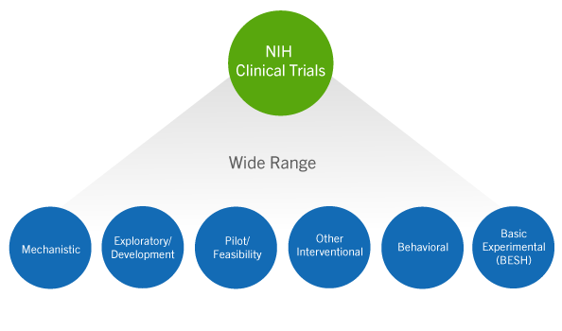
GCP Scope and Applicability
The NIH policy requiring training in GCP applies to all clinical trials involving human research participants
NIH Definition of a Clinical Trial
Notes:
NIH Definition of a Clinical Trial
A research study in which one or more human subjects are prospectively assigned to one or more interventions (which may include placebo or other control) to evaluate the effects of those interventions on health-related biomedical or behavioral outcomes.

Slide 9
Additional Requirements
Additional requirements may include but are not limited to:
Federal Regulations
Code of Federal Regulations (CFR) Title 45
Applies to research sponsored by Department of Health and Human Services (DHHS), including NIH
Code of Federal Regulations (CFR) Title 21
Applies to research involving a Food and Drug Administration (FDA) test article
Local Laws
Institutional Policies
IRB Requirements
Notes:
Federal Policy Regulations and FDA regulations
Code of Federal Regulations (CFR) Title 45
For example, 45 CFR 46: DHHS Regulations for the Protection of Human Subjects (Subpart A: ‘The Common Rule’)
Code of Federal Regulations (CFR) Title 21
Examples include: 21 CFR 11(Electronic Records/ Electronic Signatures), 21 CFR 50 (Protection of Human Subjects), 21 CFR 54 (Financial Disclosure by Clinical Investigators) parts 21 CFR 56 (IRB review/approval), 21 CFR 312 (IND) and 21 CFR 812 (medical devices)

Slide 10
Investigator/ Principal Investigator
Investigator (ICH-E6 GCP 1.34)
A person responsible for the conduct of the clinical trial at a trial site. If a trial is conducted by a team of individuals at a trial site, the investigator is the responsible leader of the team and may be called the principal investigator (PI).

Slide 11
Qualifications
Qualifications and Agreements (ICH-E6 GCP 4.1)
The investigator(s) should be qualified by education, training, and experience to assume responsibility for the proper conduct of the trial, should meet all the qualifications specified by the applicable regulatory requirement(s), and should provide evidence of such qualifications through up-to-date curriculum vitae and/or other relevant documentation requested by the sponsor, the IRB/IEC, and/or the regulatory authority(ies)
The investigator should be thoroughly familiar with the appropriate use of the investigational product(s), as described in the protocol, in the current Investigator's Brochure, in the product information, and in other information sources provided by the sponsor
The investigator should be aware of, and should comply with, GCP and the applicable regulatory requirements

Slide 12
Medical Care
Medical Care of Trial Subjects (ICH-E6 GCP 4.3)
Medical care given to subjects should always be the responsibility of a qualified physician with the PI oversight
If the subject agrees, it is recommended that the investigator inform the subject’s primary physician about their participation in the trial
Studies should be conducted in compliance with the protocol that has received IRB approval
Freely given informed consent must be obtained from every subject prior to participation
The rights, safety, and well-being of research subjects are most important and should prevail over interests of science or society

Slide 13
Resources
Adequate Resources (ICH-E6 GCP 4.2.)
Demonstrate a potential for recruiting study subjects within the agreed recruitment period
NIMH Recruitment Milestone Reporting system (RMR): Enrollment numbers should reflect only the number of subjects who have provided data to be analyzed in the final dataset
Have adequate number of qualified staff and facilities to conduct the study and sufficient time to properly conduct and complete the trial within the agreed trial period
Ensure all persons assisting with the study are informed about the protocol, investigational product (if applicable) and their study-related duties and functions

Slide 14
Study Staffing
To see subjects and/or handle study data, a study staff member must:
Have received IRB approval to work on the specific study, as applicable per Institutional policies
Have all required credentials (e.g., CV, license, training certificates) filed in the study regulatory binder
Be fully informed about the protocol and study-related tasks
Be delegated by the PI on the Delegation of Authority (DOA) Log to perform study tasks

Slide 15
Delegation of Authority
Delegation of Authority Log (DOA)
Show which study staff are delegated by the PI to conduct study-specific tasks
All staff listed on the DOA should have at minimum in the study regulatory binder:
Signed and dated CVs (and licensure if appropriate)
Human subject protection training certificates
GCP training certificates (for clinical trials)
Study-specific Training Log (e.g., CSSRS training)
The log should have a column for the PI to sign off on each staff member’s delegation individually (not one line at the end of the log)

Slide 16
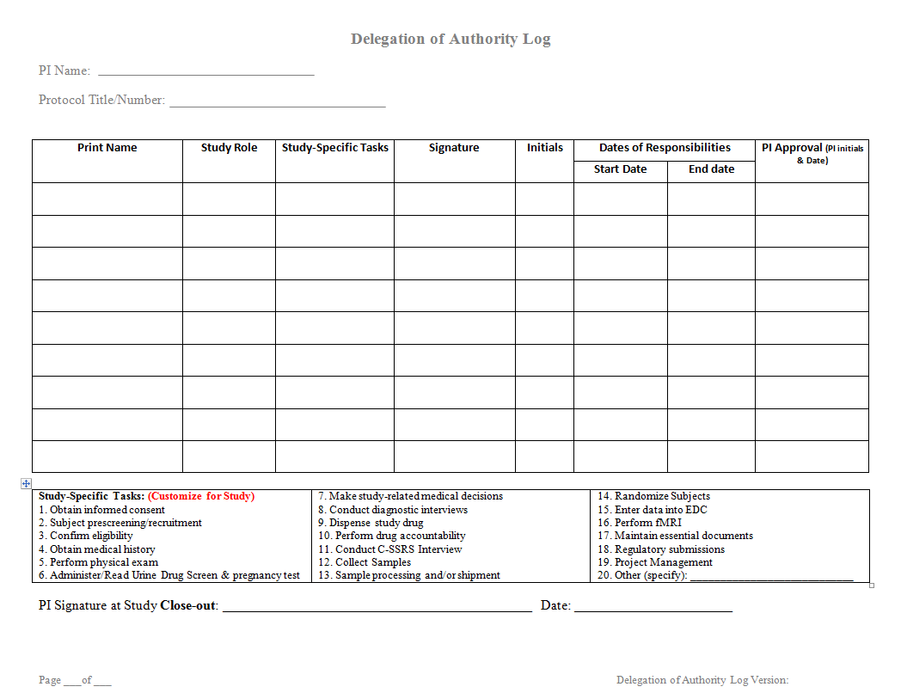
Example Delegation of Authority Log
Study start date should be after all required trainings have been completed
Customize the tasks to be specific to the study and to be comprehensive of all types of study tasks

Slide 17
Protocol/ Study Staff Meetings
Study staff should meet regularly to discuss the progress of the study
All internal and external staff meetings for this study should:
Be documented
Include the date of the meeting, list of attendees, topics discussed, decisions made, and action items
Be filed in the regulatory binder

Slide 18
Documentation
Documentation Expectations
(ICH E6 GCP 4.9. & 4.10.)
Data must be ALCOAC
Attributable
Legible
Contemporaneous
Original
Accurate
Complete
How and where the data is recorded is key!
If it’s not documented, it doesn’t exist
Data on CRFs should match the source documents (raw data)

Slide 19
Examples of ALCOAC
Attributable: a clinician collects vital signs and initials on the source document.
Legible: a PI neatly writes out a telephone contact note documenting an AE.
Contemporaneous: both the PI and subject sign the ICF on the same date.
Original: if there’s a mistake on the source, a correction is made instead of throwing the form away and starting over.
Accurate: Height of 68 inches is not written 6’8’’.
Complete: every data field on a form is filled in, including the header and staff signature line.

Slide 20
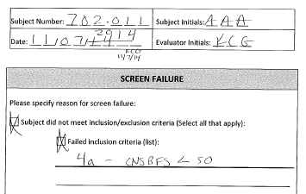
Example Documentation Corrections
The correct date was written near the mistake
A single line was drawn through the inaccurate data
The same evaluator who made the mistake initialed and dated the correction

Slide 21
Electronic Data Capture Systems (EDCs)
All EDCs should be password-protected, accessible to study staff only, and backed up regularly (ICH-E6 GCP 5.5.)
For FDA-regulated studies, electronic systems must be compliant with 21CFR11, which includes, but is not limited to:
An audit trail that captures all changes made to data
Database validation processes to ensure accuracy, reliability, consistent intended performance, and the ability to discern invalid or altered records
Implementation of enhanced electronic signatures requirements

Slide 22
Data Storage
Paper/ Hard Copy Subject File Storage (ICH-E6 GCP 4.9.4. & 4.9.5.)
All paper study forms for a subject should be located in the subject’s study binder, with the exception of unblinding forms and forms with personally identifiable information (PII) (e.g. informed consent forms, contact sheets with phone numbers)
Facilitates better safety and compliance tracking; enhances study reproducibility
Best practice is to hole-punch study documents and store them in binders to avoid loose sheets being misplaced
Stored in a locked cabinet in a locked office only accessible to study staff (not shared)
Study data collected for the present study should not be removed from a subject’s binder and placed in their binder for a different study
The location of both paper and electronic study data should be specified in the protocol and/or Manual of Procedures (MoP)

Slide 23
Document Retention
Study Document Retention after Study Closeout (ICH-E6 GCP 5.5.12. & 8)
All NIH grants:
Retain for 3 years after the final report is submitted to the NIH (NIH Grants Policy 8.4.2).
NIH grants under an IND/IDE (FDA regulations 21CFR312.62):
Retain for 2 years after a marketing application is approved for the drug;
or, if no application is to be filed or if the application is not approved for such indication, until 2 years after the investigation is discontinued and FDA is notified
If institutional policy is more conservative than the regulations above (requires longer retention timelines), follow institutional policy

Slide 24
Informed Consent
The informed consent process (45CFR46 & ICH-E6 GCP 4.8)
Distinguish clearly research vs. treatment
Do not use any potentially coercive measures
Answer all questions regarding any aspects of the study
Give participants as much time as needed to make the decision
Consent should be obtained by a qualified, IRB-approved study staff member listed on the delegation log

Slide 25
Informed Consent Continued 1
The Informed Consent Form (ICF) (45CFR46 & ICH-E6 GCP 4.8)
No study procedures should occur prior to the subject providing written informed consent
Only the current IRB-approved ICF should be signed by the subject or Legally Authorized Representative (LAR)
All subjects should receive a copy of the signed and dated informed consent form, prior to their participation in a study
If a waiver of consent is obtained for a phone screening, only the IRB-approved phone screen questions should be asked

Slide 26
Informed Consent Continued 2
Informed Consent Documentation (45CFR46 & ICH-E6 GCP 4.8)
Best practice is to complete a Documentation of Informed Consent source document after each subject is consented. This may be included on a pre- structured Case Report Form (CRF), but includes at minimum:
Name of person conducting the consent process
Date & time of consent
Statement that the subject was provided an opportunity to ask questions
Statement that the subject was provided a copy of their signed ICF
This document should not contain identifying information and should be placed in the subject’s study binder

Slide 27
Example ICF Documentation Errors
ICFs should be reviewed for completeness, accuracy, and legibility before commencing study procedures
Back and forth arrows - Not Good Clinical Practice.
Write over - Not Good Clinical Practice

Slide 28
Consenting Family/Significant Others
If diagnostic interviews are to be conducted on relatives or if significant others will participate in the treatment intervention:
Written informed consent should be obtained from anyone (unless the IRB has approved a waiver of consent):
Providing data on themselves
Providing opinions about their children
Participating in the intervention
If approved by the IRB, a parent/guardian who only provides data for a child may not need to sign an ICF him/herself (but an ICF needs to be on file for the child, signed by a LAR)
Study staff should maintain a log of all subjects and family/significant others who have signed consent

Slide 29
Consenting Vulnerable Populations
Title 45 CFR 46
Subpart B: Additional protections for pregnant women, human fetuses, and neonates
Subpart C: Additional protections for prisoners
Subpart D: Additional protections for children
ICH-E6 GCP : 4.8.10. 4.8.12., 4.8.13., 4.8.14. & 4.8.15.
Other
Initial IRB applications contain a field to indicate if vulnerable populations will be enrolled. Sites should only recruit the IRB-approved population(s)
Sites sometimes indicate that they will not enroll employees (thinking in terms of lab employees), but they do enroll university employees, which may require additional language be added to ICFs
To avoid potential coercion and data compromise, study staff should not be enrolled

Slide 30
Consenting in Emergency Situations
In emergency situations, when prior consent of the subject is not possible, the consent of the subject's legally acceptable representative, if present, should be requested.
When prior consent of the subject is not possible, and the subject’s legally acceptable representative is not available, enrollment of the subject should require measures described in the protocol and/or elsewhere, with documented approval/favorable opinion by the IRB/IEC, to protect the rights, safety, and wellbeing of the subject and to ensure compliance with applicable regulatory requirements.
The subject or the subject's legally acceptable representative should be informed about the trial as soon as possible and consent to continue and other consent as appropriate should be requested.

Slide 31
Use of Previously-Collected Data
Some studies plan to reuse diagnostic interviews conducted within the past 6 months or 1 year (e.g., SCID, DIGS, MINI)
While the best practice would be to obtain all new data for the present study, the use of previous data may be acceptable if:
Described in the NIH grant application, IRB protocol and ICF
There is an acceptable process detailed in the protocol or MoP by which a qualified study clinician reconfirms the diagnosis
The diagnostic interviews are only reused within a reasonable timeframe

Slide 32
Use of Previously-Collected Data Continued
If the study plans on reusing documents from other studies, a copy of the original source documents should be filed within the subject file for the current study
Definition of Certified Copy (ICH-E6 GCP 1.63): A copy (irrespective of the type of media used) of the original record that has been verified (i.e., by a dated signature or by generation through a validated process) to have the same information, including data that describe the context, content, and structure, as the original

Slide 33
Randomization
The PI is responsible for ensuring (ICH-E6 GCP 4.6.6. & 4.7.)
The randomization scheme is followed as described in the IRB-approved protocol
Randomization outcome is clearly documented for each subject. If study team is blinded, there is a description of who maintains the unblinded randomization list

Slide 34
Randomization Considerations
Defining procedural standards to follow when a randomized subject does not complete the protocol (e.g., being replaced or not with another subject)
Consider if the order of randomization will compromise the randomization scheme (e.g., if Subject 003 receives the study intervention before Subject 002 due to subject scheduling conflicts)
Anticipate potential scenarios (e.g., if a just randomized subject fails to fulfill the baseline requirements and the study protocol allows re-screening after being randomized, outline in the protocol if this subject will have the same randomization number after the re-screen)

Slide 35
Protocol Adherence
Protocol Deviation (ICH-E6 GCP 4.5.)
Noncompliance with the research protocol that does not increase risk or decrease benefit and/or affect the integrity of the data
Protocol deviations may result from the action of the subject, researcher, or research staff
Examples of a protocol deviation include:
A rescheduled study visit beyond protocol-specified time frame
Failure to collect an ancillary self-report questionnaire
Subject’s refusal to complete scheduled research activities
Some sites use the terms Major Deviation vs. Minor Deviation instead of Deviation vs. Violation

Slide 36
Protocol Adherence Continued
Protocol Violation (ICH-E6 GCP 4.5.)
Noncompliance with the IRB-approved protocol without prior sponsor and IRB approval
Violations generally increase risk or decrease benefit, affect the subject's rights, safety, or wellbeing, or impact the integrity of the data
Examples of protocol violations:
Failure to obtain valid informed consent
Loss of laptop computer that contained PII
Incorrect study medication or dose administered
Not following inclusion/exclusion criteria

Slide 37
Documenting Protocol Deviations and Violations
Subject Specific Protocol Deviation Log A detailed description of each deviation/violation should be available in each subject’s study file
Study-Wide Protocol Deviation Log There should be a cumulative deviation/violation log in the regulatory binder to facilitate compliance monitoring and reporting to regulatory authorities
The total number of protocol deviations is typically reported to the IRB at the time of continuing review
Protocol Violations should be reported to regulatory authorities and NIMH per protocol/policy

Slide 38
Concomitant Medications (Con-Meds)
Study protocol should include a description of whether or not con-meds will be documented, the timeframe for which con meds will be collected (e.g., past 30 days, 1 week), the frequency and the rationale
Concomitant Medication Log
Considerations for documenting con-meds:
For data analysis
For clinical care monitoring
To prevent unwanted drug interactions
To prevent confounding the outcome data

Slide 39
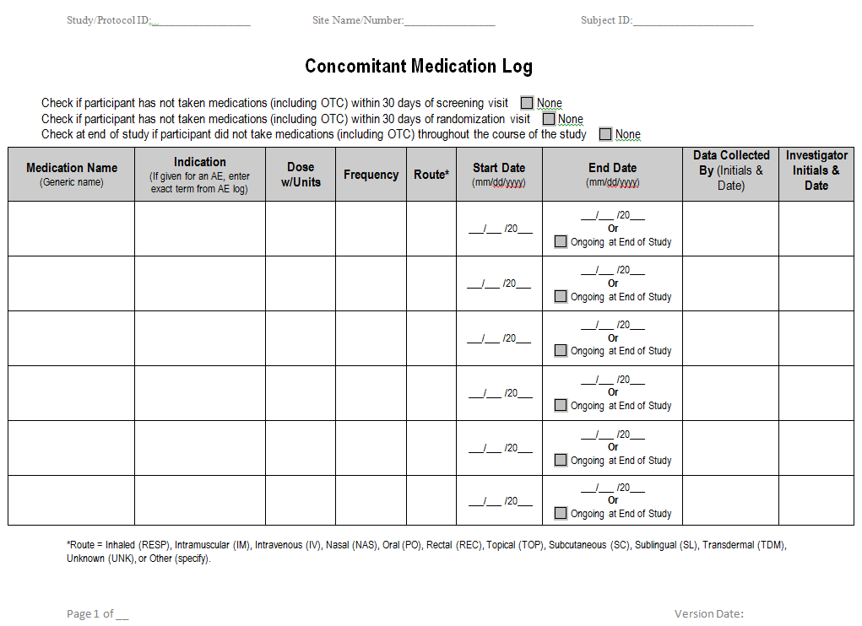
Example Concomitant Medication Log

Slide 40
Investigational Product (IP)/ Study Drug Accountability
ICH-E6 GCP 4.6., NIMH IP Management SOP
Each subject’s binder should include a drug accountability log to document the details of the subject receiving study drug
Subject IP Accountability Log
There should be a master dispense/return log to document the precise amount, location, and person responsible for study drug at all times. If study drug is picked up from the pharmacy the day before administration, this should be documented
Study-Wide IP Accountability Log
The PI should ensure a study drug destruction policy and log (if applicable) are in place before recruitment
The protocol or MoP should include a description of emergency un-blinding information

Slide 41
Adverse Event (AE)
AE= Any untoward or unfavorable medical occurrence in a human subject, including any abnormal sign (for example, abnormal physical exam or laboratory finding), symptom, or disease, temporally associated with the subject’s participation in the research, whether or not considered related to the subject’s participation in the research
See link below for additional information:
http://www.hhs.gov/ohrp/policy/advevntguid.html#AA

Slide 42
Example AE Grading Scale
https://ctep.cancer.gov/protocolDevelopment/electronic_applications/docs/CTCAE_v5_Quick_Reference_8.5x11.pdf

Slide 43
Serious Adverse Events (SAE)
SAE = Any untoward medical occurrence that:
Results in death
Is life-threatening
Requires inpatient hospitalization or prolongation of existing hospitalization
Results in persistent or significant disability/incapacity
Is a congenital anomaly/birth defect
Any other adverse event that, based upon appropriate medical judgment, may jeopardize the subject’s health and may require medical or surgical intervention to prevent one of the other outcomes listed in this definition
See link below for additional information:
http://www.hhs.gov/ohrp/policy/advevntguid.html#AA

Slide 44
Recording AEs and SAEs
Each subject should be asked about the presence/absence of AEs at every study visit, including those conducted via telephone or electronically
Protocol should specify the timeframe for collecting AEs (e.g., starting at consent or baseline visit? Ending at last study visit or 30 days after?)
Protocol and/or MoP should have AE severity grading scale
Include rules for classifying AEs that are characteristic of the study condition
Helps ensure Co-Is are classifying AEs consistently
If a Co-I is unblinded they should not make any determinations of AE relationship to study treatment

Slide 45
AE Documentation
AEs should be clearly documented in each subject’s file
Subject AE Log
Adverse events and/or laboratory abnormalities identified in the protocol as critical to safety evaluations should be reported to the sponsor according to the reporting requirements and within the time periods specified by the sponsor in the protocol
There should be a log in the regulatory binder (or a note-to-file stating its electronic location) to summarize all AEs across subjects
Facilitates safety monitoring and helps identify AE trends across subjects
Facilitates overall AE reporting to IRB and DSMB
Study-wide AE Log

Slide 46
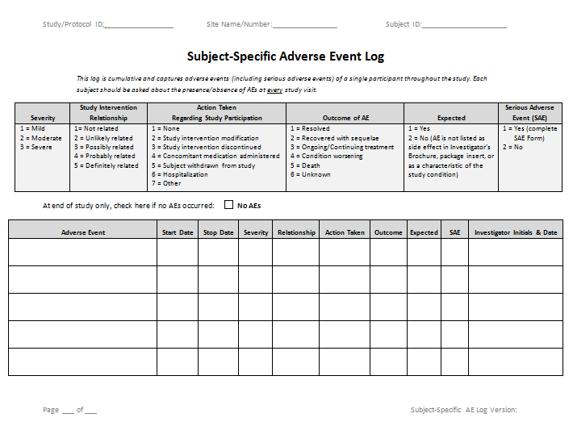
Example Subject-Specific AE Log

Slide 47
SAE Documentation and Reporting
All SAEs should be reported immediately to the sponsor except for those SAEs that the protocol or other document (e.g., Investigator's Brochure) identifies as not needing immediate reporting. The immediate reports should be followed promptly by detailed, written reports. The immediate and follow-up reports should identify subjects by unique code numbers assigned to the trial subjects rather than by the subjects' names, personal identification numbers, and/or addresses. The investigator should also comply with the applicable regulatory requirement(s) related to the reporting of unexpected serious adverse drug reactions to the regulatory authority(ies) and the IRB/IEC (ICH-E6 GCP 4.11.)
For reported deaths, the investigator should supply the sponsor and the IRB/IEC with any additional requested information (e.g., autopsy reports and terminal medical reports)
SAE Report Form:
Captures the details of the SAE and is typically sent to IRB, DSMB, Independent Safety Monitor, Medical Monitor, NIH, or other regulatory bodies as applicable
For IND/IDE studies, also report SAEs to FDA using FDA Form 3500A

Slide 48
Safety Reporting
(ICH-E6 GCP 4.11.)
The investigator should comply with the applicable regulatory requirement(s) related to the reporting of unexpected serious adverse drug reactions to the regulatory authority(ies) and the IRB/IEC
See link below for additional information:
https://www.fda.gov/media/71188/download

Slide 49
Adverse Drug Reaction (ADR)
ICH-E6 GCP 1.1. defines ADR in the context of:
Pre-approval clinical experience with a new medicinal product or its new usages, particularly as the therapeutic dose(s) may not be established: all noxious and unintended responses to a medicinal product related to any dose should be considered adverse drug reactions. The phrase “responses to a medicinal product” means that a causal relationship between a medicinal product and an adverse event is at least a reasonable possibility, i.e., the relationship cannot be ruled out
Marketed medicinal products: a response to a drug which is noxious and unintended and which occurs at doses normally used in man for prophylaxis, diagnosis, or therapy of diseases or for modification of physiological function (see the ICH Guideline for Clinical Safety Data Management: Definitions and Standards for Expedited Reporting)

Slide 50
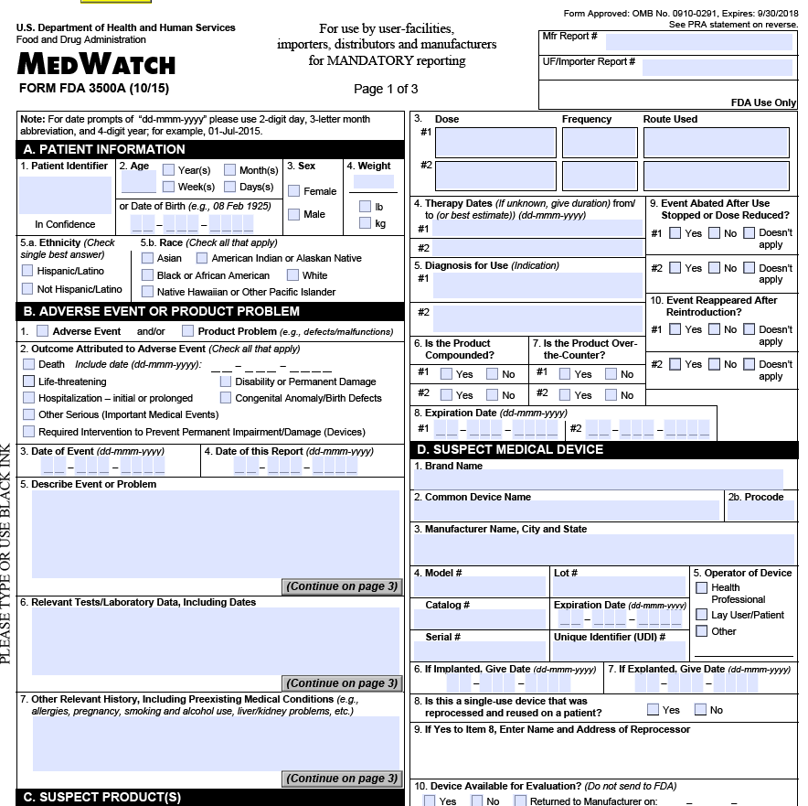
FDA Safety Reporting - FDA Form 3500A
Any unexpected fatal or life-threatening experience associated with drug use = 7 calendar days
Any unexpected, serious adverse experience associated with drug use = 15 calendar days
http://www.fda.gov/Safety/MedWatch/HowToReport/DownloadForms/default.htm

Slide 51
NIMH Reportable Events Policy
Reportable Event | When is Event Reported to the NIMH | Reported By
IRB/ISM/DSMB/OHRP/FDA Suspensions or Terminations | Any suspension or termination of approval must include a statement of the reason(s) for the action and must be reported promptly to the NIMH PO within 3 business days of receipt. | Regulatory or Monitoring Entity and Investigator
Deaths related to study participation | Deaths must be reported immediately (no later than within 5 business days) of the principal investigator first learning of the death. | Investigator
Unexpected Serious Adverse Events related to study participation | Reported to the NIMH PO within 10 business days of the study team becoming aware of the SAE. | Investigator
Unanticipated Problems Involving Risks to Subjects or Others | Reported to the NIMH PO within 10 business days of the investigator learning of the event. | Investigator
Serious or Continuing Noncompliance | Reported to the NIMH PO within 10 business days of IRB determination | Institution
Adverse Event | For all AEs and SAEs that are deemed expected and/or unrelated to the study, a summary should be submitted to the NIMH PO with the annual progress report. | Investigator
Protocol Violations | With the annual progress report. | Investigator

Slide 52
Unanticipated Problems (UP)
UP= any incident, experience, or outcome that meets all of the following criteria:
Unexpected (in terms of nature, severity, or frequency) given
(a) the research procedures that are described in the protocol-related documents, such as the IRB-approved research protocol and informed consent document; and
(b) the characteristics of the subject population being studied
Related or possibly related to participation in the research; and suggests that the research places subjects or others at a greater risk of harm (including physical, psychological, economic, or social harm) than was previously known or recognized
See link below for additional information:
http://www.hhs.gov/ohrp/policy/advevntguid.html

Slide 53
Noncompliance
Noncompliance:
Defined as a failure to follow the regulations, applicable law, institutional policy, and deliberations of the IRB
Serious Noncompliance:
Defined as noncompliance that jeopardizes the safety, rights, and welfare of participants
Continuing Noncompliance:
Defined as a repeated pattern of noncompliance

Slide 54
Noncompliance Continued
Why does noncompliance occur?
Lack of education
Lack of appreciation
Error in judgment
Not usually direct non-maleficence

Slide 55
Applying GCP to Your Study
Understanding is key to protecting subject safety and integrity of data
Monitoring and quality management help ensure compliance
Ultimately, compliance with GCP is the PI’s responsibility

Slide 56
Additional Resources
Topic | Reference
Protection of human subjects | 45 CFR 46
Staff qualifications/training | ICH-E6 GCP 4.1, ICH-E6 GCP 4.2.
Research resources | ICH-E6 GCP 4.2.
Protocol adherence | ICH E6, Sec 4.5
Record keeping | ICH E6, Sec 4.4.1, Sec 4.9, Sec 8
FAQs OHRP Investigator Responsibilities | http://answers.hhs.gov/ohrp/categories/1567
NIMH Reporting | NIMH Reportable Events Policy

Slide 57
Additional Resources Continued
ICH GCP: http://www.ich.org/products/guidelines.html
FDA Regulations: http://www.fda.gov/ScienceResearch/SpecialTopics/RunningClinicalTrials/ucm155713.htm#FDARegulations
NIMH Clinical Research Policies: http://www.nimh.nih.gov/funding/clinical-research/index.shtml
Office for Human Research Protections (OHRP): http://www.hhs.gov/ohrp/humansubjects/index.html
GCP training course: http://gcplearningcenter.niaid.nih.gov/ or https://gcp.nidatraining.org/
NIMH Clinical Research Toolbox:
https://www.nimh.nih.gov/funding/clinical-research/clinical-research-toolbox/nimh-clinical-research-toolbox.shtml
ICH Clinical Safety Data Management: Definitions and Standards for Expedited Reporting Guideline:
https://www.fda.gov/media/71188/download

Slide 58
Contact
NIMH Office of Clinical Research (OCR)
Clinical Research Education, Support, and Training (CREST) Program
Email: nimhctob_crest@mail.nih.gov

